Slide 1
BRAND WARRIOR
Tales from the frontline of Brand Marketing
By Ellen Copaken
MARCH 21, 2013

Slide 2
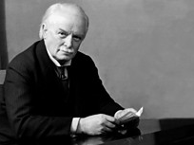
"Don't be afraid to take a big step when one is indicated. You can't cross a chasm in two small jumps."
- David Lloyd George

Slide 3
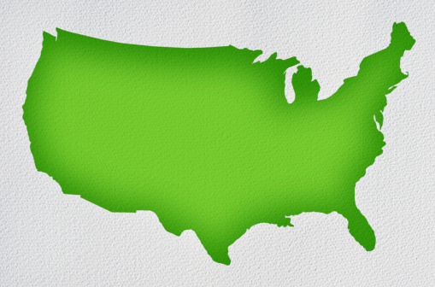












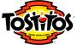
Introduction

Slide 4
Today’s agenda
Day in the Life of a Brand Manager
2 Case Studies:
Brand re-positioning: Tostitos
New brand launch: Flat Earth
Brand Marketing Careers
Notes:
1. How it ‘really’ works. That is, what kinds things you do in a normal day or your goals as a brand manager
2. Any ‘war stories’ or ways it goes wrong
3. past projects that have interesting outcomes
4. What kinds of careers you might have doing this kind of thing and how to prepare yourself and make yourself an appealing candidate for a job like this

Slide 5
Concepts you’ll recognize
Product Life Cycle
Branding Strategy
Brand Equity and Brand Personality
Product Re-positioning
Packaging

Slide 6
A Day in the life

Slide 7
Everything
What does a brand manager do?
Notes:
You are CEO of your product or brand or portfolio, whatever the scope if, you are like an entrepreneur with the resources and of course input of a large corporation

Slide 8
You have 2 key jobs:
Manage the product lifecycle
Manage the brand

Slide 9
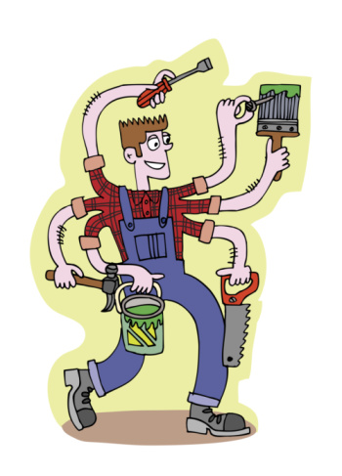
Typical daily tasks . . .

Slide 10

Track the business

Slide 11
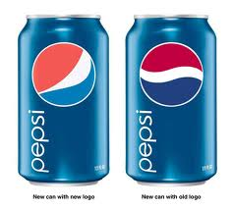
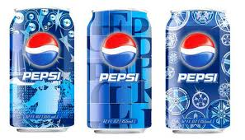
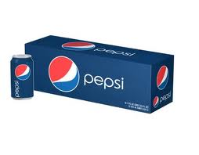
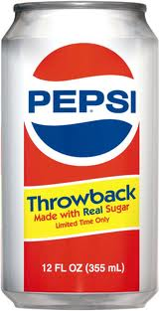
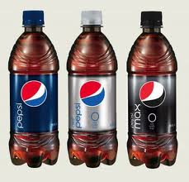
Refresh packaging

Slide 12

Manage communications and promotions
FSI

Slide 13

… From times square

Slide 14
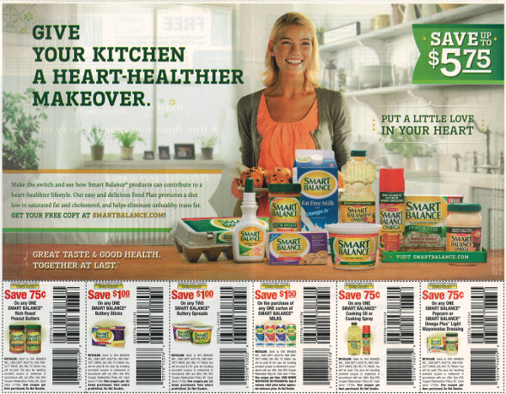
… To the weekly circular
Notes:
Pricing plays a big role too!

Slide 15
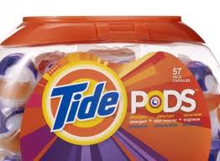
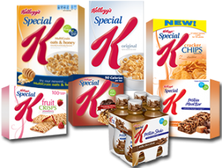
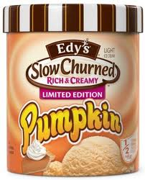
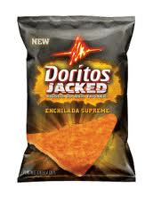
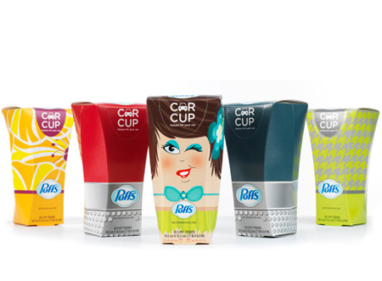
Launch new products

Slide 16

Lead taskforce

Slide 17

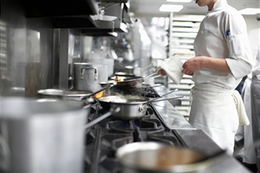


Whatever else it takes

Slide 18
Your Success is measured by . . .
Business Results +
What You Did to Impact the Business +
Your “People” Skills and Contributions

Slide 19
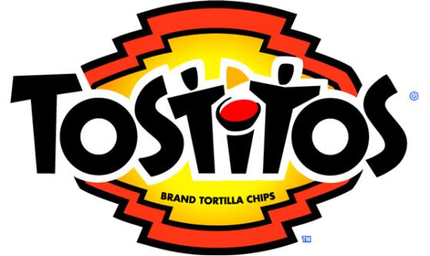
Case study #1

Slide 20
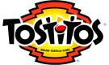
The situation (2010)
Tostitos was 30 years old (launched in 1980) and sales were declining every quarter since 2008
As one of Frito Lay’s largest and most profitable businesses, it was weighing down corporate profits
Recent efforts to make the product healthier (WHOLE GRAINS, ALL NATURAL) were not paying off
The competitive environment had become very crowded with regional and private label tortilla chips

Slide 21
4C Analysis
Company
Consumer
Competition
Customers

Slide 22
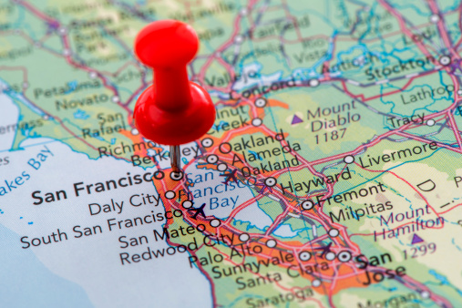
Digging into company . . .
Sales declining fastest in the West and middle-low income areas

Slide 23

According to consumers . . .
“I like Tostitos.”
Notes:
When you make something no one hates, no one loves it.
– Tibor Kalman
Talk about the party ethnographies

Slide 24
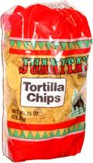
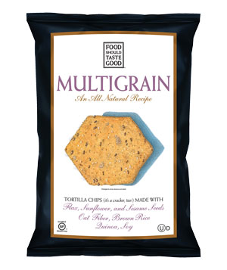
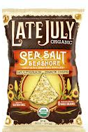
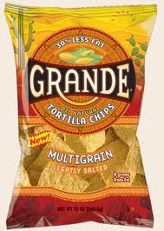
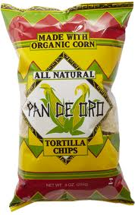
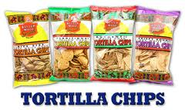
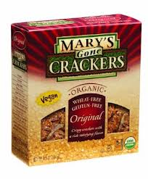
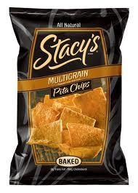
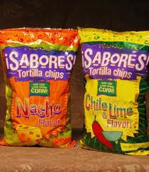
Competition was a tale of two cities
Cheap and cheerful
Premium gourmet

Slide 25
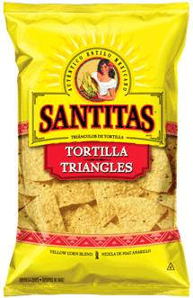
Plus, a big competitor in our own house
$2
(AKA The Fighting Brand)
Notes:
Guess who Santitas was fighting? Not an effective multibrand strategy!

Slide 26
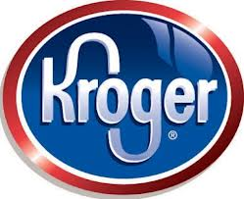
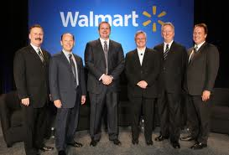

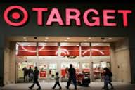
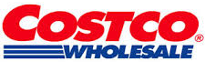
Customers agreed . . .
Tostitos was overpriced and lost its distinction

Slide 27
The problem
Tostitos was not worth paying more for

Slide 28
The key insight
Health was not a differentiator of tortilla chips

Slide 29
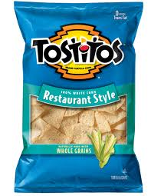
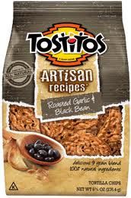
What we did
Step 1: Fix the business by managing a portfolio (multibranding strategy)

Slide 30
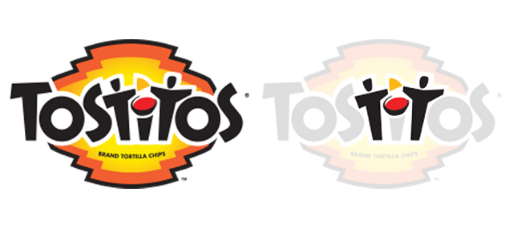
What we did
Step 2: Reinvigorate the Tostitos brand
Brand personality = social

Slide 31
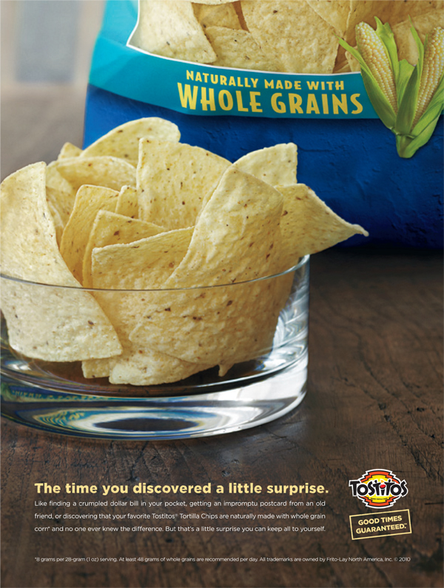
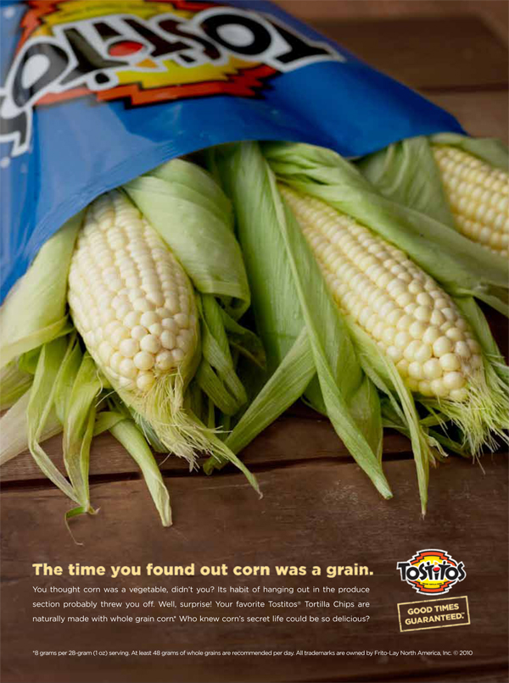
Does this feel very social?

Slide 32
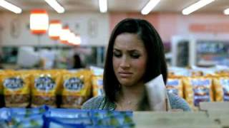
How about this?

Slide 33
Party!!!!!!
Tostitos new positioning
Notes:
Life is a party!

Slide 34
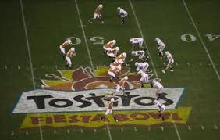
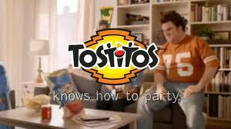
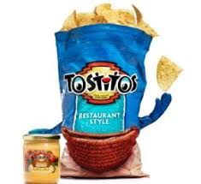
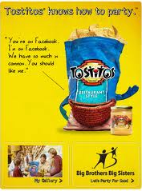
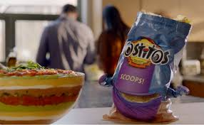
Brand re-launch at fiesta bowl 2012

Slide 35
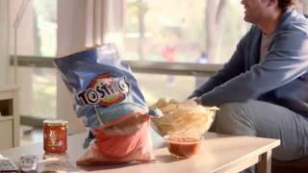

New advertising
FROM:
TO:
Notes:
Compare:
http://www.youtube.com/watch?v=t-sWa517Yh4
With:
http://www.youtube.com/watch?v=eKWEMh4dyOI
http://www.youtube.com/watch?v=_THJi4aDKNU

Slide 36
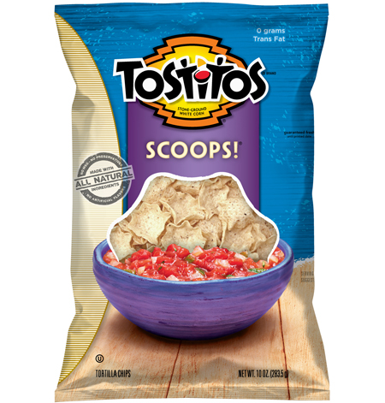
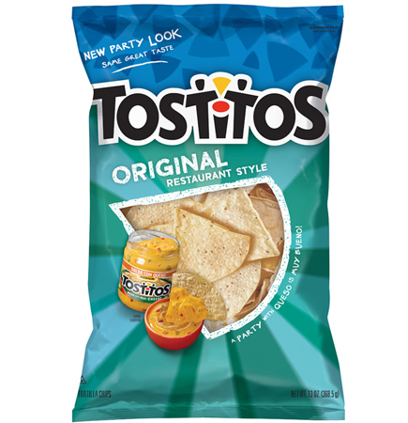
What we did
Step 3: Make Tostitos worth $4 a bag

Slide 37
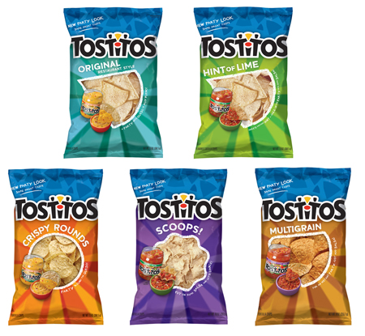
Updated packaging and enhanced product quality
Now even tastier!

Slide 38
The results
Positive, sales flattened in 1st half of 2012 and grew balance of year
Profit growth went from negative to flat
Brand momentum positive (social media buzz, p-scores)

Slide 39
Lessons learned
The importance of being different: brand distinction is key
Need to manage the brand and the business at the same time
Beware of competitors inside your own house

Slide 40

Case study #2

Slide 41
The challenge (2006)
Management asked a small group of women to launch a new snack brand that would appeal to them
Leverage R&D product breakthroughs in “snackifying” fruits and vegetables
Launch in 1 year on a limited budget
Distribute the product using Frito-Lay’s massive direct store delivery system (AKA the truck drivers)
Notes:
Explain truckdrivers

Slide 42
Healthy + Tasty
What women want

Slide 43
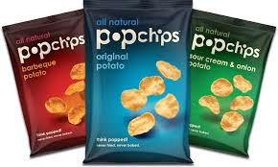
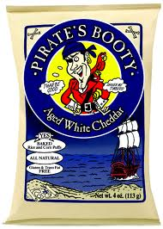

How do you create a brand that resonates?

Slide 44
The flat earth brand story
What if we made the impossible, possible?
(What if pigs could fly?)

Slide 45

Was this a good brand name?
Suggest the product benefits?
Memorable, distinctive, positive?
Fit the product image?
No legal or regulatory restrictions?
Simple and emotional?

Slide 46



Lineup of new products
Plus, Apple Cinnamon Grove, Garlic and Herb Field, and Peach Mango Paradise

Slide 47
Our introduction strategy:
Key Decision Points | Textbook recommendation | What we did
Marketing Objective | Awareness | Awareness and Differentiation
Product | One | Product line
Price | Skimming or penetration | Penetration and dealing
Promotion | Inform, educate | Inform, educate
Place | Limited | Max outlets

Slide 48

The biggest little launch of the year

Slide 49


Coming to a store near you
Show new Tostitos ads

Slide 50

Tasting is believing

Slide 51

Making pigs fly

Slide 52

Lots of national pr

Slide 53


So, how did we do?
Notes:
Doritos taco 375 million sold last year
Created 15,000 new jobs

Slide 54
But Guess what our sales plan was?
$80 Million

Slide 55
So, what went wrong?
Too much, too soon
Year 1 product overpromised
Marketing mix out of line with business objectives
Corporate expectations out of line with reality
Truck drivers not incentivized to be patient

Slide 56
Lessons learned
Manage expectations: 90% of new products fail
Be patient: product life cycles take time to build
Unite the team: lots of stakeholders can impact business results

Slide 57
careers

Slide 58
In general, 2 career paths
Marketing Manager
Brand Strategy
Packaging
Communication & Advertising
Media Planning
PR and Social Media
Brand Manager
Marketing Manager PLUS
Business tracking
P&L responsibility
Product development
Cross-functional leadership

Slide 59








In general, 2 career paths
Marketing Manager
Brand Manager

Slide 60
Brand manager rotations
Idea = expose you to as many parts of the business as possible through 12-18 month “rotations”
Big brands vs. little brands
Brand management vs. portfolio management
Consumer marketing vs. shopper marketing
National/global marketing vs. regional marketing
Innovation and new product development
Consumer insights and research

Slide 61
Questions to ask yourself
Do I like working with numbers?
Do I want to learn general manager/entrepreneurial skills?
Do I want to be heavily involved in communication strategies (vs. outsourcing to agencies)?
Do I want to work closely with people from other functions (examples: Operations, R&D)?
Ultimately, do I see myself as a CMO or a CEO?

Slide 62
Q & A
Notes:
Places to get them more involved?
So what do you guys think? What do you think of when you hear Tostitos?
Stop and talk to your neighbor for 3 minutes about differences b/t old and new Tostitos advertising

